Slide 1
PEO BES EN Kubernetes Crash Course
2020
Notes:
1

Slide 2
Agenda
Preparation
Orchestrators
Kubernetes
Deploying, scaling, updating, w/ K8s
Cloud offerings
Notes:
2

Slide 3
Preparation
Environment Prep
Don’t want to install anything?
https://labs.play-with-k8s.com/
Works from SDC
You will not be able to complete all (any?) exercises
Otherwise, See Docker Containers crash course ppt
Exercise files:
https://github.com/ericisw8n/k8sFiles (download as zip?)
Notes:
https://docs.docker.com/get-started/
3

Slide 4
Preparation (cont’d)
Personal Pre-reqs
CMD line experience (preferably - Linux/bash, Powershell)
(Docker) Containers – previous lesson
Notes:
https://docs.docker.com/get-started/
4

Slide 5
Orchestrators
Think conductor of an orchestra
Containers are the individual musicians
Conductor is the orchestrator
Manage and monitor containers
Reconcile desired state – following declarative instruction
Create/manage replicated and global services (daemon set)
Replicated – service required on specifc # of instances
Global – service required on each worker node (of a cluster)
Service Discovery – deciding/tracking container location
Notes:
5

Slide 6
Orchestrators (cont’d)
Routing
Load Balancing
Scaling
Self-healing
Zero Downtime Deployments
Rolling Updates
Canary
Blue-green
Notes:
6

Slide 7
Orchestrators (cont’d)
Affinity & location awareness
Security
Secure comms, cryptography
Policies/rules
RBAC
Secrets
Content Trust (only trusted containers/images)
Reverse Uptime – given existence time of container
Introspection – manually inspect clusters, nodes, containers
Notes:
7

Slide 8
Orchestrators (cont’d)
Popular Orchestrators
Kubernetes
Docker Swarm(Kit)
Apache Mesos and Marathon
Amazon ECS
Microsoft ACS
Notes:
8

Slide 9
Kubernetes
Kubernetes = K8s
Greek for Helmsman
ARCHITECTURE
Cluster(s) - set of servers (VMs or physical)
Master (nodes; you want 3+) – manage the cluster
Worker (nodes) – run application load(s)
Pods – run “similar” containers on workers
Underlay network – “physical” network
Overlay network – internal networks
Raft Consensus Group/Protocol – etcd(s) use to coordinate; allows group decision making
Etcd – data, state info of the cluster
Notes:
9

Slide 10
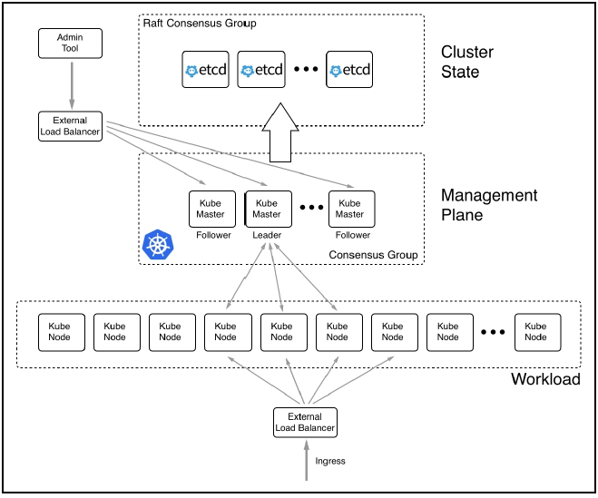
Kubernetes (cont’d)
Notes:
10

Slide 11
Kubernetes (cont’d)
MASTER
API server – all admin task info served thru here
Controller – maintains cluster (desired) state
Scheduler – manages which pods get put on which worker nodes
Cluster store – etcd, stores cluster state info
Notes:
11

Slide 12
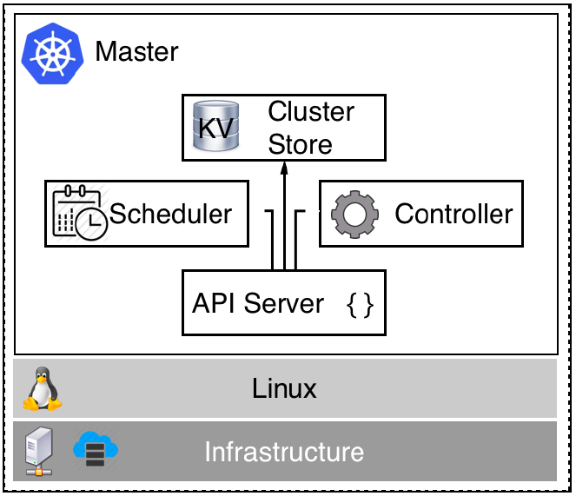
Kubernetes (cont’d)
Notes:
12

Slide 13
Kubernetes (cont’d)
WORKER/NODE
Kubelet – makes sure all containers and pods are healthy
Container runtime – manages/runs containers
Kube-proxy – network proxy, load balancer for loads
Notes:
13

Slide 14
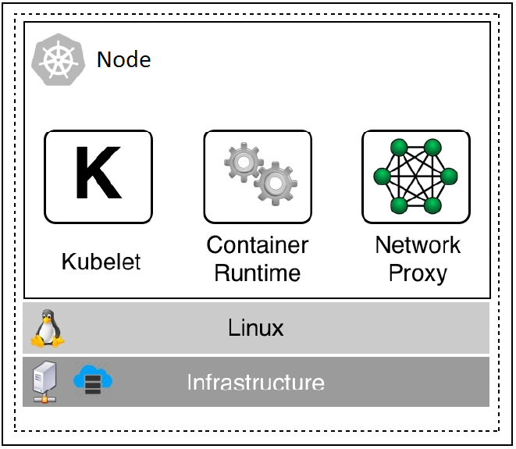
Kubernetes (cont’d)
Notes:
14

Slide 15
Kubernetes (cont’d)
T - MINIKUBE – (dev) tool, worker/master, single node cluster
T & D Kubectl – K8s CLI tool
START!
T – open (powershell) terminal as admin
$ minikube delete
$ minikube start
Notes:
15

Slide 16
Kubernetes (cont’d)
START! (cont’d)
D – Open Docker Desktop (click click)), Settings, Kubernetes, Enable Kubernetes, Apply & Restart
Also, system tray - right click Docker Desktop, Kubernetes, Docker- Desktop
T & D – $ kubectl get nodes
$ kubectl cluster-info
*** copy/paste IP to text file.
From powershell: $ ipconfig
Look for “Ethernet adapter vEthernet (Default Switch):”
*** copy/paste IP into text file.
Notes:
16
Other commands we may need to determine IPs we may need for web browsers: https://medium.com/@lizrice/accessing-an-application-on-kubernetes-in-docker-1054d46b64b1
https://rominirani.com/tutorial-getting-started-with-kubernetes-with-docker-on-mac-7f58467203fd

Slide 17
Kubernetes (cont’d)
Start dashboard
T –
New terminal window (as admin)
$ minikube dashboard
should open in (default) new browser window
D –
YAML file that creates dashboard (short timeout!)
$ kubectl apply -f recommended.yml
Notes:
17
https://kubernetes.io/docs/tasks/access-application-cluster/web-ui-dashboard/

Slide 18
Kubernetes (cont’d)
Start dashboard (cont’d)
D - (cont’d)
Get admin token to log into dashboard:
$ kubectl -n kubernetes-dashboard describe secret $(kubectl -n kubernetes-dashboard get secret | sls admin-user | ForEach-Object { $_ -Split '\s+' } | Select -First 1)
Copy/Paste Token(s) into text file
New terminal window (as admin):
$ kubectl proxy
Notes:
18

Slide 19
Kubernetes (cont’d)
Start dashboard (cont’d)
D – (cont’d)
Paste in browser - http://localhost:8001/api/v1/namespaces/kubernetes-dashboard/services/https:kubernetes-dashboard:/proxy/
From Token text file: copy admin token.
Then paste token in dashboard login window.
Notes:
19

Slide 20
Kubernetes (cont’d)
Manually create/deploy a 1-container, single pod
kubectl run hello-nginx --image=nginx --restart=Never --port=80
Create access Service, expose for external access (K8s determines port/mapping)
kubectl expose pod hello-nginx --type=NodePort
Determine IP:port of service
T – $ minikube service --url=true hello-nginx
D – $ ipconfig (look for “Ethernet adapter vEthernet (Default Switch):”
Notes:
20

Slide 21
Kubernetes (cont’d)
Determine IP:port of service (cont’d)
D - (cont’d)
$ kubectl get services
Copy-paste IP:port in web browser
Or use curl
Check dashboard too
Notes:
21

Slide 22
Kubernetes (cont’d)
Clean up
kubectl get pods
kubectl delete po/hello-nginx
kubectl get services
kubectl delete svc/hello-nginx
Notes:
22

Slide 23
Kubernetes (cont’d)
More on Pods:
Pod – 1/more containers sharing a single kernel/network namespace
Notes:
23

Slide 24
Kubernetes (cont’d)
Docker container vs K8s networking:
Pod “pause” containers allow use of same network space
Notes:
24

Slide 25
Kubernetes (cont’d)
Docker container vs K8s networking (cont’d):
Containers in the same pod/namespace communicate w/ each other via localhost
External comms via:
IP:port
Service
Ingress controller
Notes:
25

Slide 26
Kubernetes (cont’d)
Pod status:
Pending – pod and containers being created
Running – pod and all containers up and running
Succeeded – pod and all containers terminate, no errors
Failed – container of the pod fails/terminates with errors
Refresher:
Imperative – specify exactly what to do, and how; no room for “error”
Declarative – describe end state to be achieved; how is left to orchestrator
Notes:
26

Slide 27
Kubernetes (cont’d)
Pods and volumes:
Create a claim/local volume on the VM/physical host
VSCode: Open, view, save/move volume-claim.yml
$ kubectl create -f volume-claim.yml
kubectl get pvc
PVC = persistent volume claim
Create pod to “use” volume
VSCode: Open and view pod-with-vol.yml
kubectl create -f pod-with-vol.yml
Notes:
Volume-claim.yml:
apiVersion: v1
kind: PersistentVolumeClaim
metadata:
name: my-data-claim
spec:
accessModes:
- ReadWriteOnce
resources:
requests:
storage: 2Gi
Pod-with-vol.yml:
apiVersion: v1
kind: Pod
metadata:
name: web-pod
spec:
containers:
- name: web
image: nginx:alpine
ports:
- containerPort: 80
volumeMounts:
- name: my-data
mountPath: /data
volumes:
- name: my-data
persistentVolumeClaim:
claimName: my-data-claim
27

Slide 28
Kubernetes (cont’d)
Prove volume/data persists
Exec into container, create file; delete pod, recreate it
$ kubectl exec -it web-pod -- /bin/sh
# cd /data
# echo “does it stick?” > sample.txt
# exit
$ kubectl delete pod/web-pod
kubectl create -f pod-with-vol.yml
kubectl exec -it web-pod -- /bin/sh
# cd /data
# ls
# exit
Notes:
28

Slide 29
Kubernetes (cont’d)
Clean up
$ kubectl delete pod/web-pod
kubectl delete -f volume-claim.yml
Notes:
29

Slide 30
Deploying, Scaling, Updating
Deployments – rolling updates, rollbacks for ReplicaSets
ReplicaSets – set of identical pods, HA, etc., achieving Desired State
Notes:
30

Slide 31
Deploying, Scaling, Updating (cont’d)
Create a simple deployment with replicaset:
nginx-deployment.yml
apiVersion: apps/v1
kind: Deployment
metadata:
name: nginx-deployment
labels:
app: nginx
spec:
replicas: 3
selector:
matchLabels:
app: nginx
template:
metadata:
labels:
app: nginx
spec:
containers:
- name: nginx
image: nginx:1.7.9
ports:
- containerPort: 80
Notes:
Go here and do this next:
https://kubernetes.io/docs/concepts/workloads/controllers/deployment/
https://devopscube.com/kubernetes-deployment-tutorial/
31

Slide 32
Deploying, Scaling, Updating (cont’d)
Create a simple deployment with replicaset (cont’d):
$ kubectl apply -f nginx-deployment.yml
kubectl get deployments
…Check K8s dashboard, too. And:
kubectl get rs
kubectl get pods --show-labels
Yay! HA, 3 instance nginx web server(s).
Clean up…
$ kubectl delete deployment/nginx-deployment
Notes:
Go here and do this next:
https://kubernetes.io/docs/concepts/workloads/controllers/deployment/
32

Slide 33
Deploying, Scaling, Updating (cont’d)
Complications of multi-instance application service
Web API needs to connect to each (micro) service, but how?
Each service is a pod, with short lifecycle, no “stable” IP/ID.
Notes:
33

Slide 34
Deploying, Scaling, Updating (cont’d)
Kubernetes Services!
Stable endpoints to ReplicaSets and Deployments
Cluster-wide IP (VIP), unique reliable port
Labels are used by the
selector to find each object
Kind of like DNS and proxies…
Notes:
34

Slide 35
Deploying, Scaling, Updating (cont’d)
Even more complicated: context based routing (layer 7) – using an IngressController
Again, think DNS, proxies, and port forwarding
Notes:
35

Slide 36
Deploying, Scaling, Updating (cont’d)
Back to the Deployment and Replicaset
AND we’re gonna work on updates/upgrades!
Create a Deployment, 3 replicas, with exposed service:
deploydemo.yml (open in VSCode first)
$ kubectl apply -f deploydemo.yml
QUICKLY Check deployment/rollout status
kubectl rollout status deployment.v1.apps/nginx
Check K8s dashboard, to be sure
Check web browser (IP:port), nginx home page
$ kubectl get services
Notes:
apiVersion: apps/v1
kind: Deployment
metadata:
name: nginx
labels:
app: nginx
annotations:
monitoring: "true"
spec:
replicas: 3
selector:
matchLabels:
app: nginx
template:
metadata:
labels:
app: nginx
spec:
containers:
- image: nginx:1.7.9
name: nginx
ports:
- containerPort: 80
---
apiVersion: v1
kind: Service
metadata:
labels:
app: nginx
name: nginx
spec:
ports:
- nodePort: 30500
port: 80
protocol: TCP
targetPort: 80
selector:
app: nginx
type: NodePort
36

Slide 37
Deploying, Scaling, Updating (cont’d)
Rolling update/upgrade nginx from 1.7.9 to 1.9.1
kubectl set image deployment/nginx nginx=nginx:1.91
Again, check deployment/rollout status
kubectl rollout status deployment.v1.apps/nginx
Check web browser (IP:port), ensure no downtime
Check K8s dashboard
Check cmd line status of deployment/update
kubectl describe deployment
Oh no! Nginx is jacked and we need the previous version!
Notes:
37

Slide 38
Deploying, Scaling, Updating (cont’d)
Rollback:
Check revision history
kubectl rollout history deployment.v1.apps/nginx
Check each revision, determine correct rollback
kubectl rollout history deployment.v1.apps/nginx -- revision=1
Then rollback
kubectl rollout undo deployment.v1.apps/nginx --to- revision=1
Check to make sure…
Through Proportional Scaling, there’s no downtime
Notes:
38

Slide 39
Deploying, Scaling, Updating (cont’d)
Clean up…
$ kubectl delete deployment/nginx
$ kubectl delete svc/nginx
Notes:
39

Slide 40
Deploying, Scaling, Updating (cont’d)
Blue-Green Deployments
Current release = Blue
New release = Green
We (will) create 2 deployments (Blue, Green) and a single (separate) service
1 – deploydemo-blue.yml (Open in VSCode first)
2 – deploydemo-green.yml ( “ )
3 – nginx-svc-blue-green.yml ( “ )
Deploy blue
$ kubectl apply -f deploydemo-blue.yml
Check dashboard
Notes:
deploydemo-blue.yml:
apiVersion: apps/v1
kind: Deployment
metadata:
name: nginx-blue
labels:
app: nginx
annotations:
monitoring: "true"
spec:
replicas: 1
selector:
matchLabels:
app: nginx
service: web
color: blue
template:
metadata:
labels:
app: nginx
service: web
color: blue
spec:
containers:
- image: nginx:1.7.9
name: nginx
ports:
- containerPort: 80
deploydemo-green.yml:
apiVersion: apps/v1
kind: Deployment
metadata:
name: nginx-green
labels:
app: nginx
annotations:
monitoring: "true"
spec:
replicas: 1
selector:
matchLabels:
app: nginx
service: web
color: green
template:
metadata:
labels:
app: nginx
service: web
color: green
spec:
containers:
- image: nginx:1.9.1
name: nginx
ports:
- containerPort: 80
nginx-svc-blue-green.yml:
apiVersion: v1
kind: Service
metadata:
labels:
app: nginx
name: web
spec:
ports:
- nodePort: 30500
port: 80
protocol: TCP
targetPort: 80
selector:
app: nginx
service: web
color: blue
type: NodePort
40

Slide 41
Deploying, Scaling, Updating (cont’d)
Deploy service
kubectl apply -f nginx-svc-blue-green.yml
Check dashboard, check web browser (IP:port), also:
curl IP:port
…and note “last modified date” for nginx “versioning”
Deploy green
kubectl apply -f deploydemo-green.yml
Check dashboard, also:
kubectl get deploy
If deployment went well, switch “live” from Blue to Green
kubectl edit svc/web
…change color from blue to green, save, exit
Notes:
41

Slide 42
Deploying, Scaling, Updating (cont’d)
Check dashboard, check web browser (IP:port), also:
curl IP:port
…and note “last modified date” for nginx “versioning”
Your app has been updated, with minimal/no downtime!
Clean up…
$ kubectl delete deployment/nginx-blue
kubectl delete deployment/nginx-green
kubectl delete svc/web
Notes:
42

Slide 43
Cloud Offerings
AWS
Azure
Google
Notes:
43

Slide 44
Sources
https://kubernetes.io/docs/concepts/workloads/controllers/deployment/
https://www.mirantis.com/blog/introduction-to-yaml-creating-a-kubernetes-deployment/
https://devopscube.com/kubernetes-deployment-tutorial/
https://kubernetes.io/docs/tasks/access-application-cluster/create-external-load-balancer/
https://kubernetes.io/docs/concepts/services-networking/service/#loadbalancer
http://john-cd.com/cheatsheets/Containers/Minikube_Install_on_Windows/
https://rominirani.com/tutorial-getting-started-with-kubernetes-on-your-windows-laptop-with-minikube-3269b54a226
https://medium.com/bitnami-perspectives/imperative-declarative-and-a-few-kubectl-tricks-9d6deabdde
https://kubernetes.io/docs/reference/kubectl/conventions/
https://stackoverflow.com/questions/52890718/kubectl-run-is-deprecated-looking-for-alternative
http://Labs.play-with-docker.com
Https://romanirani.com/tutorial-gettin-started-with-kubernetes-on-your-windows-laptop-with-minikube-3269b54a226
http://John-cd.com/cheatsheets/containers/minikube_install_on_windows
https://docs.docker.com/engine/docker-overview/
Notes:
44

